Slide 1

Async, Await, Oh… Wait!
You’d better watch your step December 2016 – Alt.Net Paris
@tpierrain (use case driven)

Slide 2



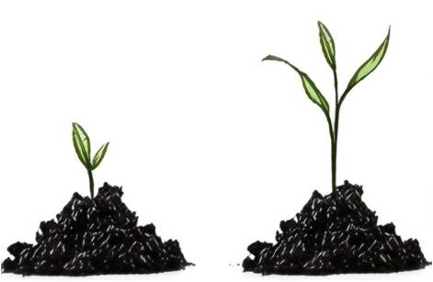

“Use Case Driven”, but also…
Reactive Programmer (> 10 years)
eXtreme Programmer (> 10 years)
Programmer (> 18 years)
NFluent
Value (DDD)
@tpierrain

Slide 3

Notes:
Ref: http://www.world-of-knives.ch/public/media/filer_thumbnails/2011/11/14/fk-140wh-wh_5_5_3.jpg__663x372_q80_crop-1_upscale-1.jpg

Slide 4
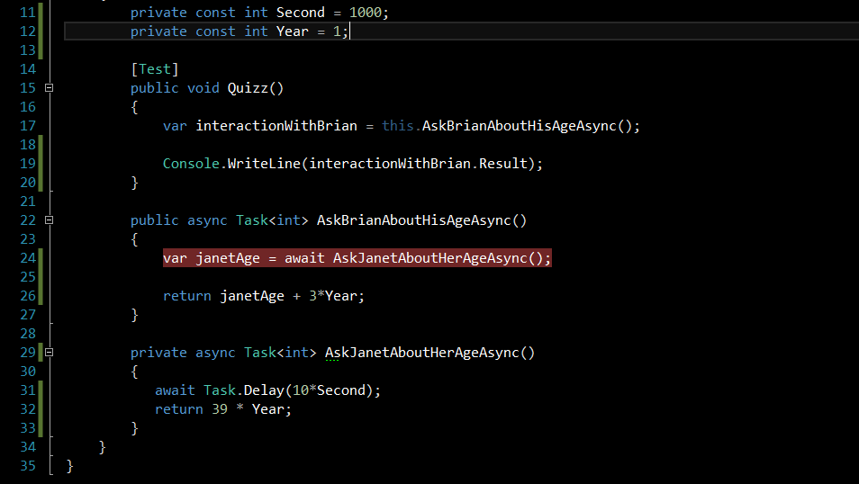
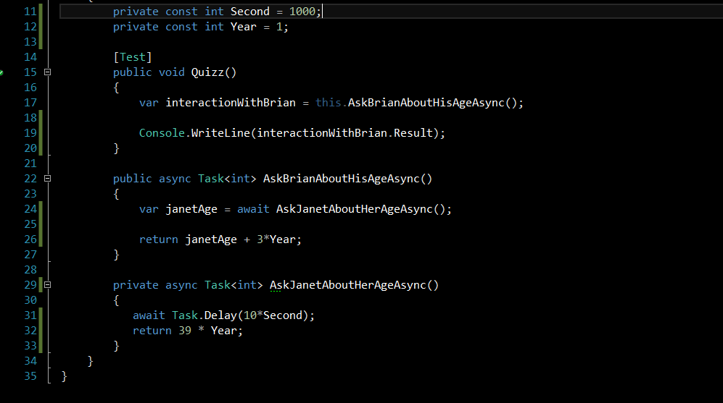
Let’s start with A question…

Slide 5
Let’s start with A question…
Q: What happens line 24, when await occurs?

Slide 6
Oups! Let’s Add some context

Slide 7
Let’s start with A question…
Q: What happens line 24, when await occurs?

Slide 8
Let’s start with A question…
Q: What happens line 24, when await occurs?

Slide 9
Let’s start with A question…
1

Slide 10
Let’s start with A question…
1

Slide 11
Let’s start with A question…
1

Slide 12
Let’s start with A question…
1

Slide 13
Let’s start with A question…
1

Slide 14
Let’s start with A question…
1

Slide 15
Let’s start with A question…
1

Slide 16

Let’s start with A question…
1
2

Slide 17
Let’s start with A question…
1
2

Slide 18
Let’s start with A question…
1
2

Slide 19
Let’s start with A question…
1
2

Slide 20
Let’s start with A question…
1
2

Slide 21
Let’s start with A question…
1
2

Slide 22
Let’s start with A question…
1

Slide 23
Let’s start with A question…
1
2

Slide 24
Let’s start with A question…
1
2

Slide 25
Let’s start with A question…
1
2

Slide 26
Let’s start with A question…
1
2

Slide 27
Let’s start with A question…
1
2

Slide 28
Let’s start with A question…
2
1

Slide 29
Let’s start with A question…
2
1
1

Slide 30
Let’s start with A question…
1

Slide 31
Let’s start with A question…
1

Slide 32

Was IT your first answer?
Replay?
Notes:
Ref: http://images.martechadvisor.com/images/uploads/content_images/cbc928ab5eb5e7f00676992442650b40.jpg

Slide 33

Guess what…
Same code in ASP.NET or UI Context
will deadlock!
Notes:
Ref:http://i.imgur.com/ZnREN.jpg

Slide 34
Oh… Wait! Agenda
Why
What
How
Pitfalls & Recommendations

Slide 35
Chapter 1: Why

Slide 36

Like me, You don’t like Waste?
Notes:
Ref: http://blog.canacad.ac.jp/wpmu/15matser/files/2013/06/FoodWaste1.jpg

Slide 37

A simple rule to avoid waste of CPU

Slide 38
Async-await intention is...
…To easily transform
synchronous code ➔ asynchronous code
(Without hurting your existing code structure)

Slide 39

Without hurting your existing code structure
Notes:
Ref : http://www.careofcars.com/wp-content/uploads/2014/01/patchwork-on-cheap-cars.jpg

Slide 40

Wait a minute… Asynchronous, Concurrent, Parallel?
Notes:
Ref: http://ci.memecdn.com/7869512.jpg

Slide 41


synchronous
Asynchronous
Perform something here and now.
The caller thread will be blocked until it’s done
Initiate something here and now (off-loading).
The caller thread is released immediately
Free for something else
No waste of CPU resource ;-)
Notes:
Refs :
- https://cdn3.iconfinder.com/data/icons/basic-mobile-part-3/512/prisoner-512.png
- https://cdn4.iconfinder.com/data/icons/human-values-solid/100/_-62-512.png
- https://d30y9cdsu7xlg0.cloudfront.net/png/89995-200.png

Slide 42
synchronous
Asynchronous
Perform
Initiate
This is about invocation! (not about how the Goddamn thing is executed)
Notes:
Refs :
- https://cdn3.iconfinder.com/data/icons/basic-mobile-part-3/512/prisoner-512.png
- https://cdn4.iconfinder.com/data/icons/human-values-solid/100/_-62-512.png
- https://d30y9cdsu7xlg0.cloudfront.net/png/89995-200.png

Slide 43
What about execution

Slide 44
Concurrency
Multiple “threads” of execution
Independent logical segments
Notes:
Not OS threads
e.g.:
JavaScript in a browser
Node.js
e.g.:
Thread-based (e.g. multi-threading)
Task-based (e.g. TPL)

Slide 45
Concurrency
Parallelism
Multiple “threads” of execution
Independent logical segments
Concurrency + Simultaneous execution
Notes:
Not OS threads
e.g.:
JavaScript in a browser
Node.js
e.g.:
Thread-based (e.g. multi-threading)
Task-based (e.g. TPL)

Slide 46
Concurrency
Parallelism
Multiple “threads” of execution
Independent logical segments
Concurrency + Simultaneous execution
This is about Execution! (of the Goddamn thing ;-)
Notes:
Not OS threads
e.g.:
JavaScript in a browser
Node.js
e.g.:
Thread-based (e.g. multi-threading)
Task-based (e.g. TPL)

Slide 47
Chapter 2: What

Slide 48
Async-Await is Not About Going Async

Slide 49
Async-Await is About Composing the Async

Slide 50
Composing the Async
With Task continuations
Notes:
Refs :
- https://cdn3.iconfinder.com/data/icons/basic-mobile-part-3/512/prisoner-512.png
- https://d30y9cdsu7xlg0.cloudfront.net/png/89995-200.png

Slide 51
Chapter 3: How

Slide 52
(Prerequisite - TPL)

Slide 53
Task Parallel Library reminder (TPL)
3 ways to instantiate and run a TASK:
var task = Task.Run(lambda);
var task = new Task(lambda).Start();
Task.Factory.StartNew(lambda);
Notes:
New Task().Start() est un peu moins perf car il doit éviter les races conditions pour éviter que plusieurs threads ne démarrent chacun la tache.

Slide 54
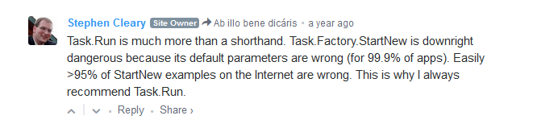
Task Parallel Library reminder (TPL)
3 ways to instantiate and run a TASK:
var task = Task.Run(lambda);
var task = new Task(lambda).Start();
Task.Factory.StartNew(lambda);
Notes:
New Task().Start() est un peu moins perf car il doit éviter les races conditions pour éviter que plusieurs threads ne démarrent chacun la tache.

Slide 55
Task Parallel Library reminder (TPL)
3 ways to instantiate and run a TASK:
var task = Task.Run(lambda);
var task = new Task(lambda).Start();
Task.Factory.StartNew(lambda);
task.Wait(), task.Result & task.Exception ( all blocking ;-(
Notes:
New Task().Start() est un peu moins perf car il doit éviter les races conditions pour éviter que plusieurs threads ne démarrent chacun la tache.

Slide 56
Task Parallel Library reminder (TPL)
Continuation
A Task that will be achieve once a previous Task has finished
var continuationTask = previousTask.ContinueWith(lambda);
PreviousTask
ContinuationTask

Slide 57
Async-Await

Slide 58
Async-Await

Slide 59
Async
GENERATES STATE MACHINE

Slide 60
Await
Marks a continuation

Slide 61
Async

Slide 62
Async
GENERATES STATE MACHINE

Slide 63
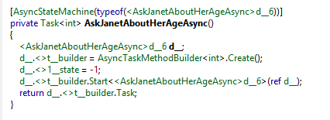
Async
GENERATES STATE MACHINE
At Compile time

Slide 64
Async
GENERATES STATE MACHINE
At Compile time

Slide 65
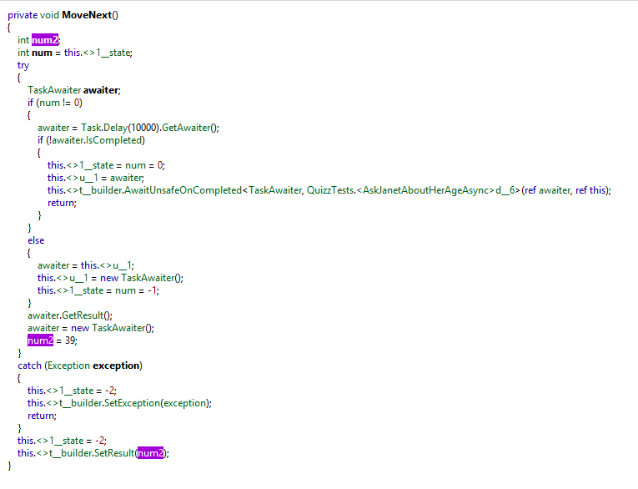
Async
GENERATES STATE MACHINE
At Compile time

Slide 66
Await

Slide 67
Await
Marks a continuation

Slide 68
Await
Returns to the caller with a Continuation task

Slide 69
Who’s doing the continuation?
Well… it depends ;-)

Slide 70
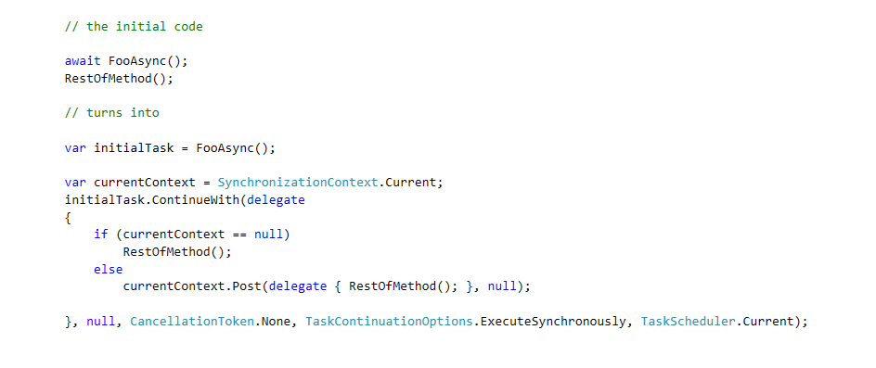
It depends on the awaiter context
The following code:

Slide 71
It depends on the awaiter context
The following code:
Is equivalent to:
WinForms,
WPF,
ASP.NET…

Slide 72
Async-Await
GENERATES STATE MACHINE
Marks a continuation

Slide 73
Thread(s) or no thread?

Slide 74

Windows I/O: under the hood
Notes:
Ref: https://static1.squarespace.com/static/544d2af6e4b007f43083a5b0/544e719be4b07c493b25c4e4/54625440e4b0f79db69b3b1a/1417724183061/?format=1500w

Slide 75
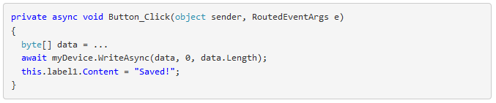
Windows I/O: under the hood

Slide 76
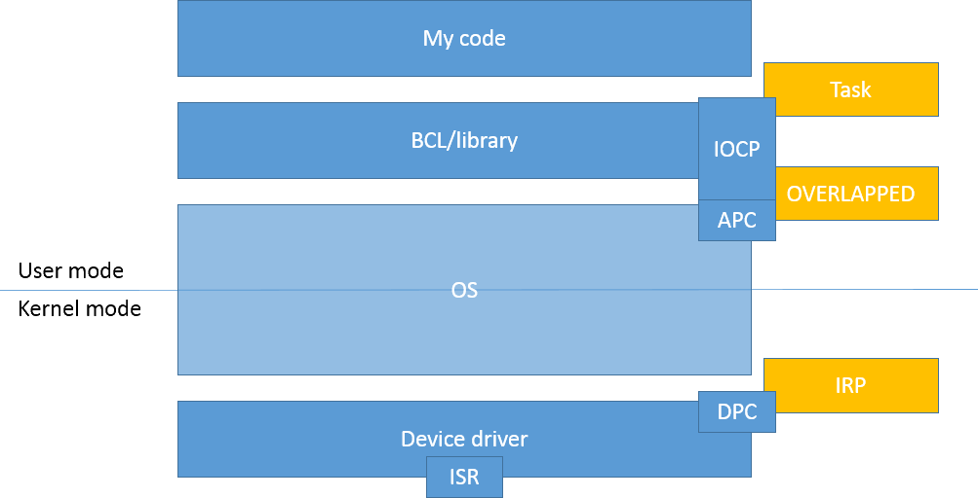
Windows I/O: under the hood
User mode
Kernel mode

Slide 77
Windows I/O: under the hood
UI thread
User mode
Kernel mode
Thread

Slide 78
Windows I/O: under the hood
BCL.WriteAsync()
User mode
Kernel mode
Thread

Slide 79
Windows I/O: under the hood
P/Invoke handle
User mode
Kernel mode
Thread

Slide 80
Windows I/O: under the hood
User mode
Kernel mode
Create I/O Request Packet (IRP)
(asynchronous)
Thread

Slide 81
Windows I/O: under the hood
Return Task (await)
User mode
Kernel mode
Thread

Slide 82
Windows I/O: under the hood
Release UI thread
User mode
Kernel mode
Thread

Slide 83

Windows I/O: under the hood
User mode
Kernel mode
NO Thread

Slide 84
Windows I/O: under the hood
User mode
Kernel mode
Interrupt!
NO Thread

Slide 85

Windows I/O: under the hood
User mode
Kernel mode
Interrupt Service Routine (ISR)
NO Thread

Slide 86
Windows I/O: under the hood
User mode
Kernel mode
Queue
Deferred Procedure Call (DPC).
NO Thread

Slide 87
Windows I/O: under the hood
User mode
Kernel mode
Mark IRP
as completed
NO Thread

Slide 88
Windows I/O: under the hood
Create Asynchronous Procedure Call (APC)
to notify the UI process (handle)
User mode
Kernel mode
NO Thread

Slide 89
Windows I/O: under the hood
Execute
APC via I/O Completion port (IOCP) thread
User mode
Kernel mode
Thread

Slide 90
Windows I/O: under the hood
Execute
APC via I/O Completion port (IOCP) thread
User mode
Kernel mode
Thread

Slide 91
Windows I/O: under the hood
Post the continuation for UI thread execution
User mode
Kernel mode
Thread

Slide 92
Windows I/O: under the hood
User mode
Kernel mode

Slide 93
Windows I/O: under the hood
Execute continuation (UI thread)
User mode
Kernel mode
Thread

Slide 94
Windows I/O: under the hood
Execute continuation (UI thread)
User mode
Kernel mode
Thread

Slide 95

Windows I/O: under the hood
User mode
Kernel mode
Replay?

Slide 96
Chapter 4: Pitfalls & Recos

Slide 97
#1: Deadlock

Slide 98
Initial Question, but in a GUI context
1

Slide 99
Initial Question, but in a GUI context
1

Slide 100
Initial Question, but in a GUI context
1

Slide 101
Initial Question, but in a GUI context
1

Slide 102
Initial Question, but in a GUI context
1

Slide 103
Initial Question, but in a GUI context
1

Slide 104
Initial Question, but in a GUI context
1

Slide 105
Initial Question, but in a GUI context
1
2

Slide 106
Initial Question, but in a GUI context
1
2

Slide 107
Initial Question, but in a GUI context
1
2

Slide 108
Initial Question, but in a GUI context
1
2

Slide 109
Initial Question, but in a GUI context
1
2

Slide 110
Initial Question, but in a GUI context
1
2

Slide 111
Initial Question, but in a GUI context
1

Slide 112
Initial Question, but in a GUI context
1
2

Slide 113
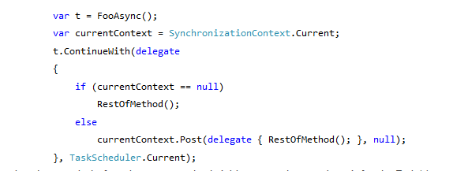
Initial Question, but in a GUI context
1
x
The GUI case

Slide 114

Initial Question, but in a GUI context
1
x

Slide 115

Notes:
Ref: http://www.designnation.de/Media/Galerie/50cf9c1d197e0,Houston-we-have-a-problem.jpg

Slide 116
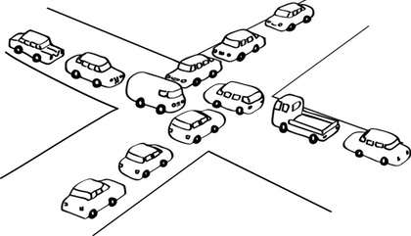
Deadlocks

Slide 117
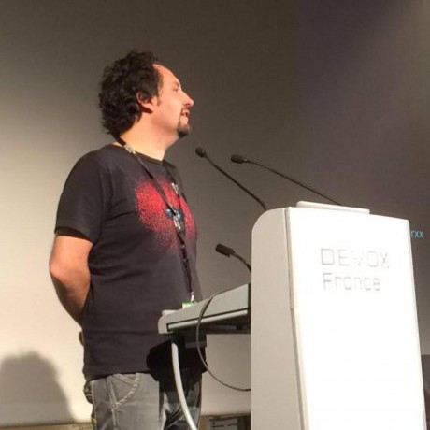
The dupdob principle
“Qui dit lockS… dit deadlocks”
“whoever locks… eventually deadlocks”
@cyrdup
Notes:
Ref: https://avatars1.githubusercontent.com/u/3131866?v=3&s=460

Slide 118
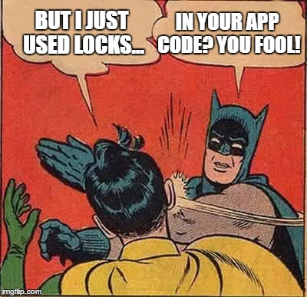
Deadlock Meme
Notes:
Ref: http://ci.memecdn.com/7869512.jpg

Slide 119
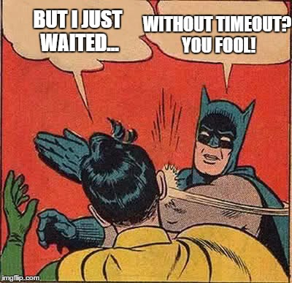
Deadlock Meme
Notes:
Ref: http://ci.memecdn.com/7869512.jpg

Slide 120
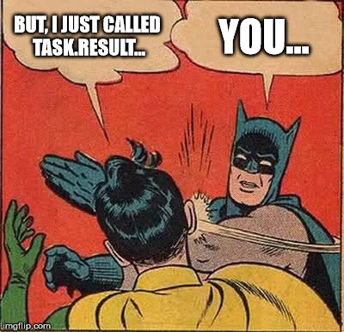
Deadlock Meme
Notes:
Ref: http://ci.memecdn.com/7869512.jpg

Slide 121
Do not block to avoid Deadlock

Slide 122
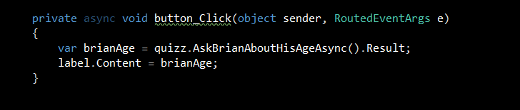
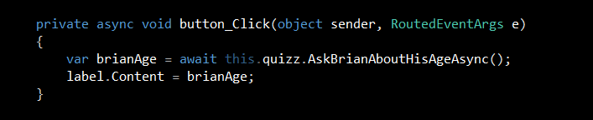
Do not block to avoid Deadlock
« await » don’t block the UI thread

Slide 123
You code A library?
Synchronization context is not your Decision!
Use ConfigureAwait(false) everywhere!
Avoid DeadlockS
Improve performance

Slide 124
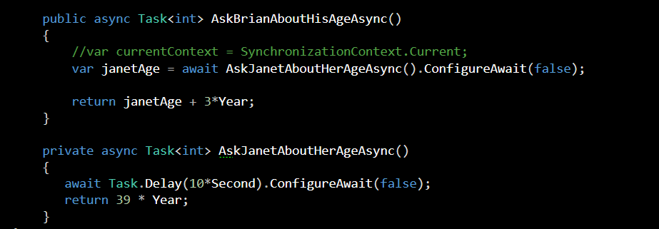
You code A library?
Use ConfigureAwait(false) everywhere!

Slide 125
#2: Enter the Async void

Slide 126
The Async void case
Async void is a “fire-and-forget” mechanism...
The caller is unable to know when an async void has finished
The caller is unable to catch exceptions thrown from an async void
(instead they get posted to the UI message-loop)

Slide 127
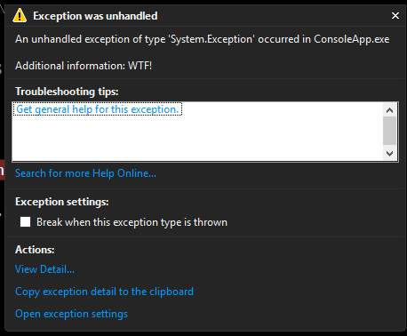
The Async void case
Async void is a “fire-and-forget” mechanism...
The caller is unable to know when an async void has finished
The caller is unable to catch exceptions thrown from an async void
(instead they get posted to the UI message-loop)

Slide 128
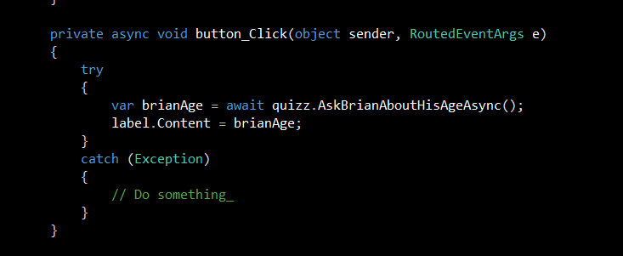
Try-catch your event handlers!

Slide 129
MS Guidelines
Use async void methods only for top-level event handlers (and their like)
Use async Task-returning methods everywhere else
Try-Catch your Async event handlers!

Slide 130
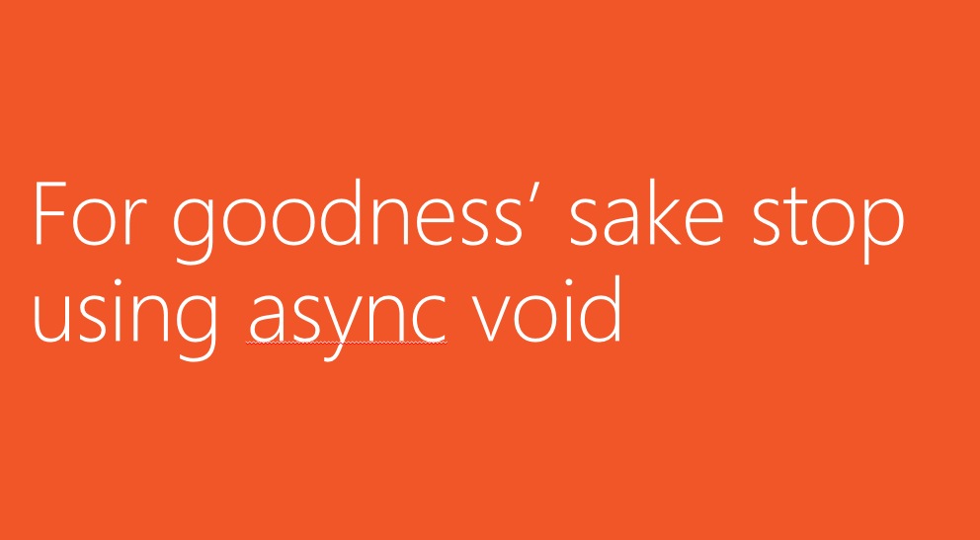
MS even said:

Slide 131
#3: Use It wisely

Slide 132
only for I/O!

Slide 133
Wrap-up

Slide 134

Wrap-up
Never block! Unless you want to deadlock
Locks, Wait without timeout, Task.Result…
Use top-level await when coding UI or Web
Use ConfigureAwait(false) everywhere within your libraries
Never create « async void » methods
And try catch all such existing event handlers
Only for I/Os
Don’t use Async-Await
unless you understand how it works

Slide 135
Thanks!

Slide 136
Appendix

Slide 137
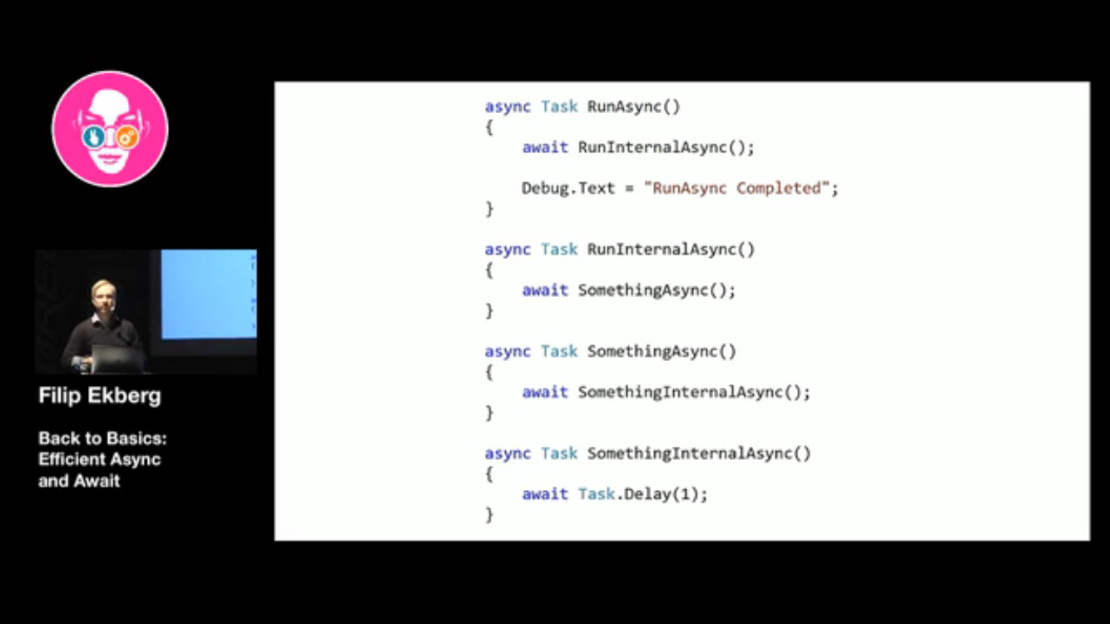

Don’t systematize Async-await?
StateMachine
StateMachine
StateMachine
StateMachine
StateMachine
Nothing in the continuation?
No need for await! (unless for ‘using’)

Slide 138
Async method GC impact
3 allocations for every Async method
Heap-allocated state machine
With a field for every local variable in your method
Completion delegate
Task

Slide 139
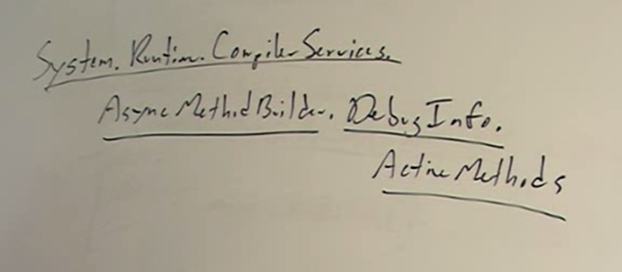
Troubleshooting?
Namespace
public type
nested type
static method

Slide 140
Few refs
Bart De Smet deep dive: https://channel9.msdn.com/Events/TechDays/Techdays-2014-the-Netherlands/Async-programming-deep-dive
Filip Ekberg at Oredev 2016: https://vimeo.com/191077931
Async-Await Best practices: https://msdn.microsoft.com/en-us/magazine/jj991977.aspx
Compiler error: http://stackoverflow.com/questions/12115168/why-does-this-async-await-code-generate-not-all-code-paths-return-a-value
Task.Run etiquette: http://blog.stephencleary.com/2013/11/taskrun-etiquette-examples-dont-use.html
There is no thread: http://blog.stephencleary.com/2013/11/there-is-no-thread.html
Does using Tasks (TPL) library make an application multithreaded? : http://stackoverflow.com/questions/23833255/does-using-tasks-tpl-library-make-an-application-multithreaded
Eliding Async-Await : http://blog.stephencleary.com/2016/12/eliding-async-await.html

